Slide 1
Exertis
Book In Portal
Training Manual

Slide 2
Exertis Book In portal
Welcome to the new Exertis Book In portal.
The purpose of this presentation is to give an overview of our new booking in portal for both carrier/ Vendor.
We will be moving away from daily emails from carriers/ Vendors and goods inwards.
Vendors and carriers must sign up to the portal to allow booking of goods to commence.

Slide 3
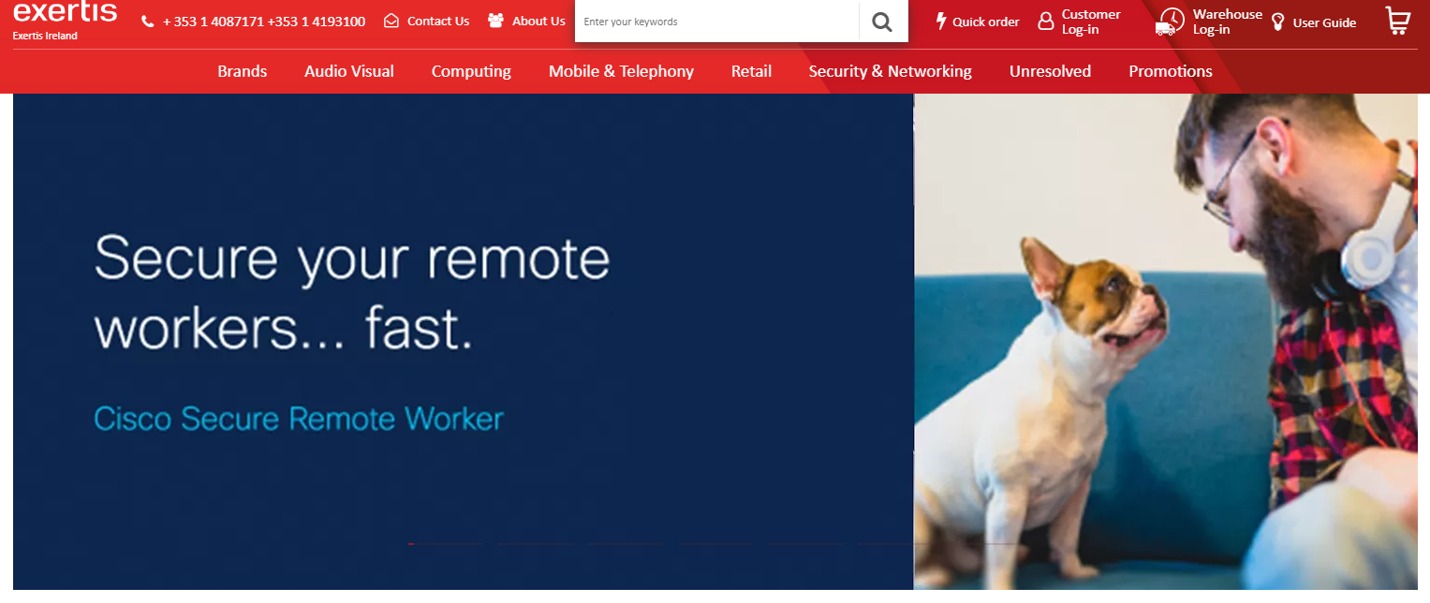
Exertis Book In portal
On www.exertis.ie ; Click on Log-in
Rephrase it in a proper sentence to invite the carriers and vendors not to use a user email.

Slide 4
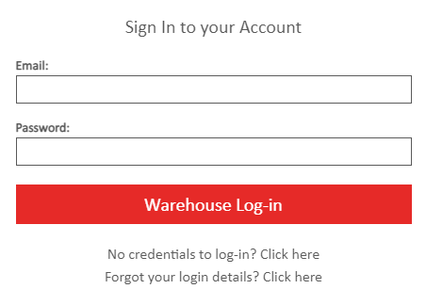
EXERTIS BOOK IN PORTAL
To log onto the Goods inwards portal please choose this icon.
You will be asked to enter your email address and password
If you have forgotten your password you can click this link. You will then receive an email to reset it.

Slide 5
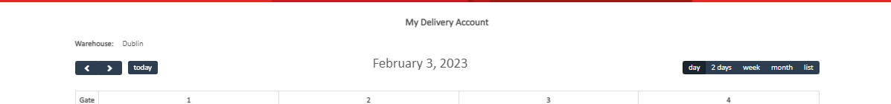
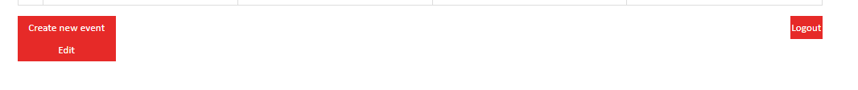
EXERTIS BOOK IN PORTAL
Once logged in, you can check your booked event or you can create a new event.
Scroll to the bottom of the page and hit the “Create new event” button for a new booking slot.
You can also edit a booking you have if the need arises by clicking the “Edit” button.

Slide 6
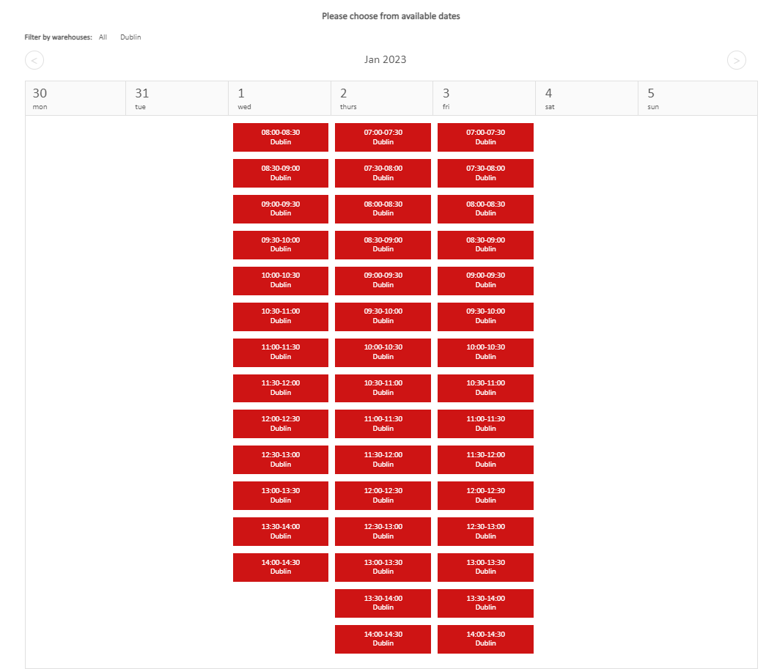
EXERTIS BOOK IN PORTAL
The calendar will appear for the full week ahead. Any time slots in red are available time slots for you to choose your booking in time and date.
Select any available 30 minutes slot.
If you cannot find the required slot, regrettably, Exertis.ie cannot accommodate your request on your expected date or time.

Slide 7

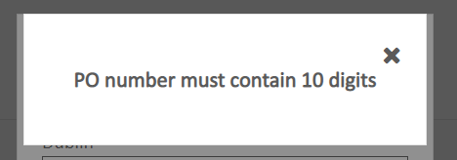
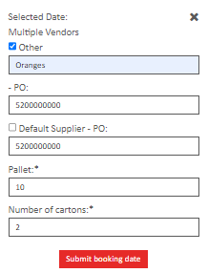
EXERTIS BOOK IN PORTAL
Click on the date/ time you would like to request your delivery to arrive into Exertis. You will be presented with the below pop up screen.
All details must be filled out. Exertis Po will need to be provided to complete the booking and must contain the 10 digits that Exertis use as PO’s.
You will not be able to proceed without the correct PO reference provided to the Vendor at time of processing.
In the case of a carrier with multiple vendors for delivery you will need to provide all vendor details also on the book in page.

Slide 8
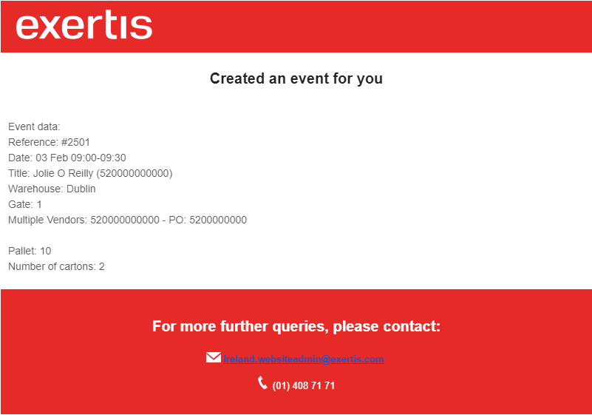
EXERTIS BOOK IN PORTAL
Providing Exertis accept the book in request, you will then receive an email to the email address provided confirming your booking.
The carrier must quote the reference number provided at time of booking when the delivery arrives at Exertis. Failure to do so could result in the delivery being refused.

Slide 9
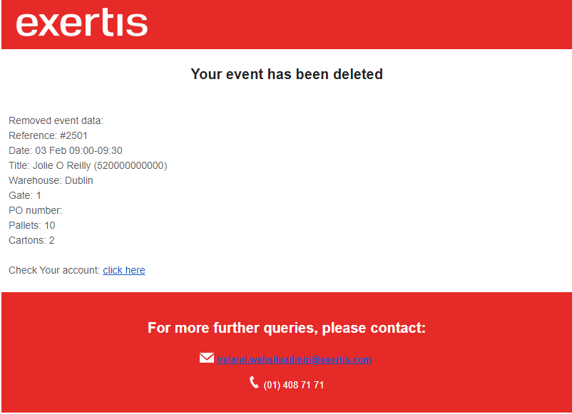
EXERTIS BOOK IN PORTAL
In the event that Exertis cannot accept your delivery you will receive an email like the below.
You will then need to make a new booking for a different date or time.

Slide 10

EXERTIS BOOK IN PORTAL

